Slide 1
24
7
30
Date
Index Laws – Mini lesson 1
EQ – How to use Index Laws 1 to 3 and Zero Index
What terminology will I expect to see when using Index Laws
Terminology –
Base
Index, Indices, Power, Exponent
Index Form, Power Form, Index Notation
Extended Form, Expanded Form, Factor Form
In the questions –
Expand
Simplify
Find, Solve, Evaluate, Calculate, Express
1
Notes:
Lesson objective (EQ)

Slide 2
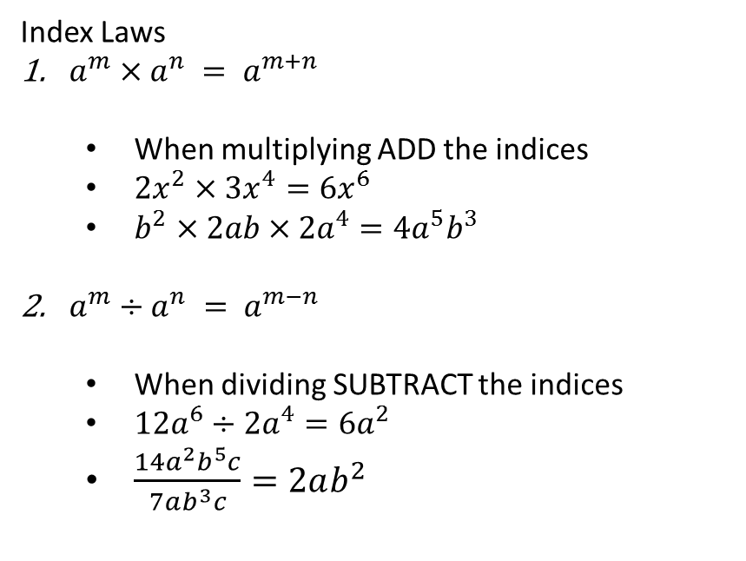
24
7
30
Date
Index Laws – Mini lesson 1
EQ – How to use Index Laws 1 to 3 and Zero Index
What are Index Laws 1 to 3
Index Laws
$a^{m}×a^{n} = a^{m+n}$
When multiplying ADD the indices
$2x^{2}×3x^{4}=6x^{6}$
$b^{2}×2ab×2a^{4}=4a^{5}b^{3}$
$a^{m}÷a^{n} = a^{m−n}$
When dividing SUBTRACT the indices
$12a^{6}÷2a^{4}=6a^{2}$
$\frac{14a^{2}b^{5}c}{7ab^{3}c}=2ab^{2}$
2
Notes:
Input

Slide 3
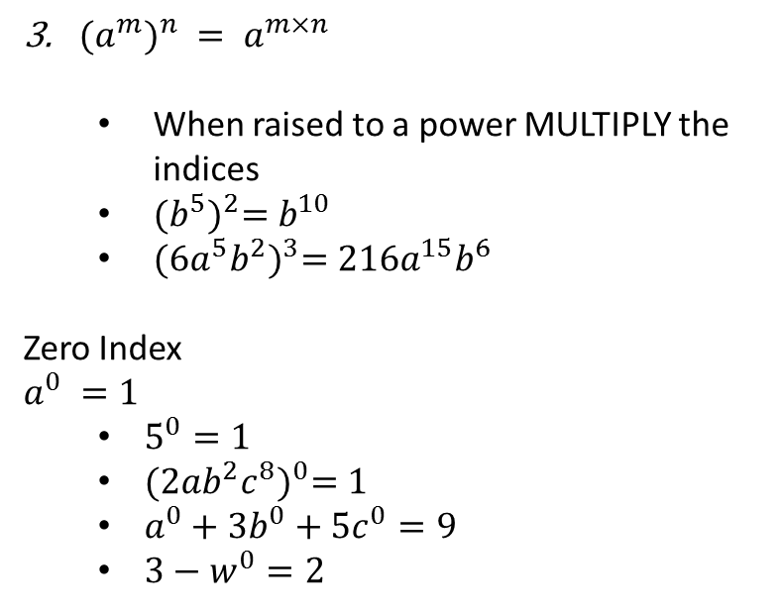
24
7
30
Date
Index Laws – Mini lesson 1
EQ – How to use Index Laws 1 to 3 and Zero Index
${{(a}^{m})}^{n} = a^{m×n}$
When raised to a power MULTIPLY the indices
${(b^{5})}^{2}=b^{10}$
${(6a^{5}b^{2})}^{3}=216a^{15}b^{6}$
Zero Index
$$a^{0} =1$$
$5^{0}=1$
${(2ab^{2}c^{8})}^{0}=1$
$a^{0}+3b^{0}+5c^{0}=9$
$3−w^{0}=2$
What is the ‘Zero Index’ law.
3
Notes:
Input

Slide 4
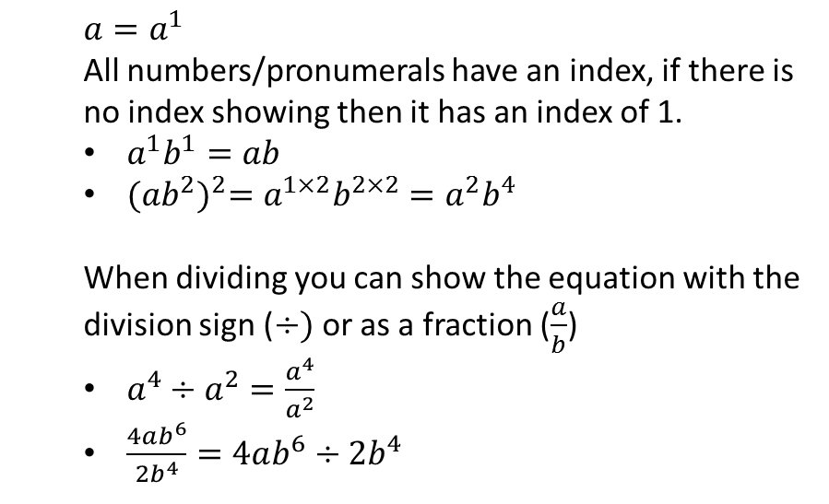
24
7
30
Date
Index Laws – Mini lesson 1
EQ – How to use Index Laws 1 to 3 and Zero Index
Things to remember
$$a=a^{1}$$
All numbers/pronumerals have an index, if there is no index showing then it has an index of 1.
$a^{1}b^{1}=ab$
${(ab^{2})}^{2}=a^{1×2}b^{2×2}=a^{2}b^{4}$
When dividing you can show the equation with the division sign ($÷)$ or as a fraction ($\frac{a}{b}$)
$a^{4}÷a^{2}=\frac{a^{4}}{a^{2}}$
$\frac{4ab^{6}}{2b^{4}}=4ab^{6}÷2b^{4}$
4
Notes:
Input

Slide 5
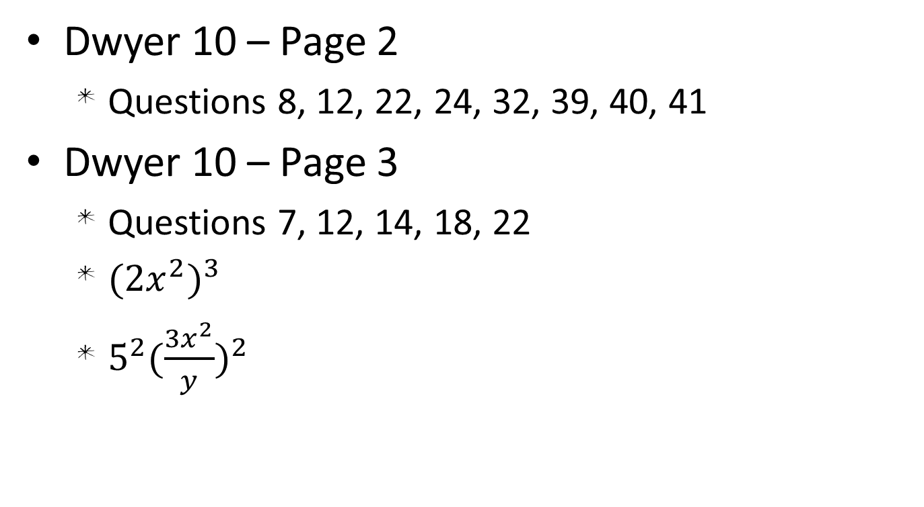
Activity
Dwyer 10 – Page 2
Questions 8, 12, 22, 24, 32, 39, 40, 41
Dwyer 10 – Page 3
Questions 7, 12, 14, 18, 22
${(2x^{2})}^{3}$
$5^{2}{(\frac{3x^{2}}{y})}^{2}$
Notes:
Independent practice

Slide 6
Closure activity
Thumbs up
Notes:
Closure

